Slide 1
EXPERIMENT DESIGN:
MCF7 estrogen receptor positive human breast cancer cell lines were treated with 2 different types of estrogens, Estradiol (E2) or Estrone (E1), for 4 hours with or without previous stimulation for 4 hours with TNFa, an NF-kB pathway activator, having a total of 6 different conditions:
C → untreated cells
E2 → cells treated for 4 hours with E2 (Estradiol)
E1 → cells treated for 4 hours with E1 (Estrone)
TNFa → cells treated for 8 hours with TNFa but not estrogens
TNFa E2 → cells treated for 8 hours with TNFa and the last 4 hours with E2 (Estradiol)
TNFa E1 → cells treated for 8 hours with TNFa and the last 4 hours with E1 (Estrone)
RNA was collected and library prepared using ribosomal RNA depletion preserving both mRNA a non-coding RNA
RNA-seq was performed using paired end (for possible analysis of splicing differences..) and 60 millions reads were obtained from each sample
I also added ERCC spike-in to use as reference for the analysis of the samples

Slide 2
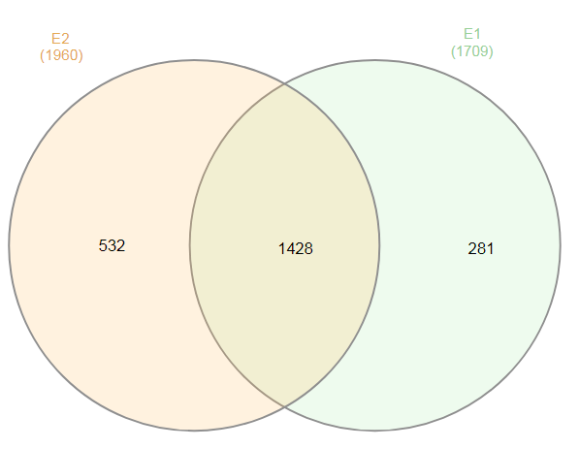
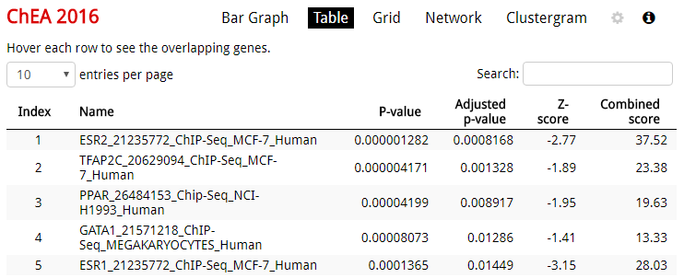
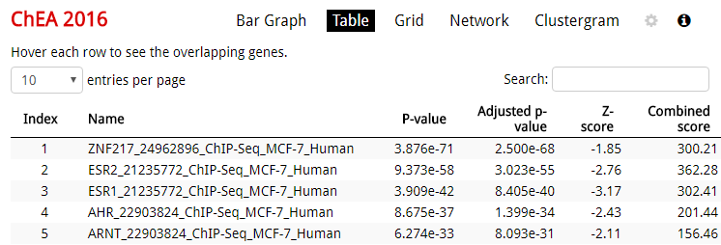
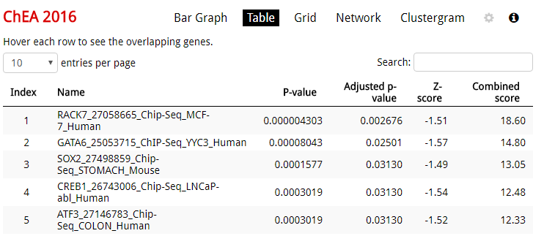
ANALYSIS TO BE PERFORMED:
There are differences in gene expression/pathway regulation when compared C vs E2 and C vs E1?
Here it is an example of my preliminary analysis for this study
E2 VS E1
The complete analysis should include also an study of which genes/pathways are upregulated and which downregulated (not only significantly changed as shown in this example)

Slide 3
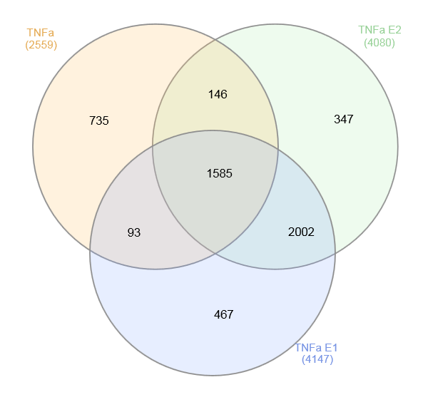
ANALYSIS TO BE PERFORMED:
There are differences in gene expression/pathway regulation when compared C vs TNFa, C vs TNFa E2 and C vs TNFa E1?
Here it is an example of my preliminary analysis for this study
TNFa VS TNFa E2 VS TNFa E1
The complete analysis should include also an study of which genes/pathways are upregulated and which downregulated (not only significantly changed as shown in this example)

Slide 4
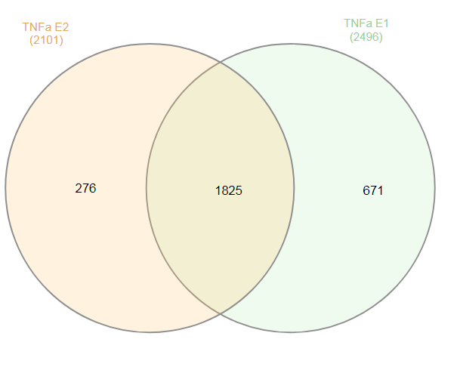
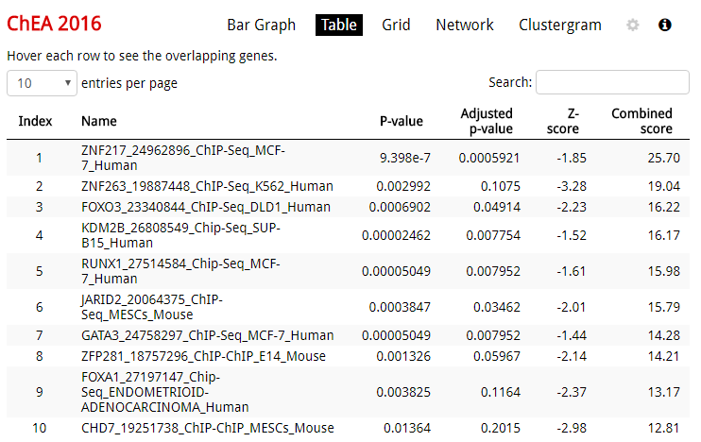
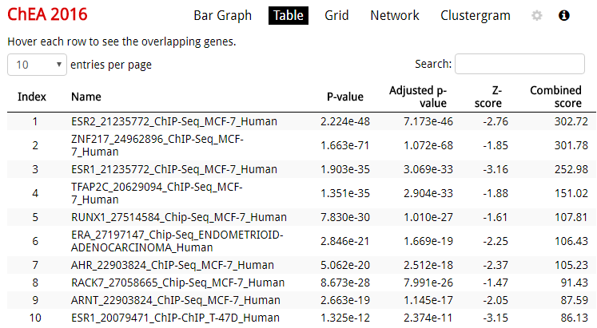

ANALYSIS TO BE PERFORMED:
There are differences in gene expression/pathway regulation when compared TNFa vs TNFa E2 and TNFa vs TNFa E1?
Here it is an example of my preliminary analysis for this study
TNFa E2 VS TNFa E1
The complete analysis should include also an study of which genes/pathways are upregulated and which downregulated (not only significantly changed as shown in this example)

Slide 5
ANALYSIS TO BE PERFORMED:
Once this analysis are completed, I would like to perform also other studies that we will discus more in detail, including:
- Analysis using ERCC spike-in as reference not reads
- Changes in miRNA and/or non-coding RNA if possible with the data generated
- Changes in splicing variants

